Slide 1
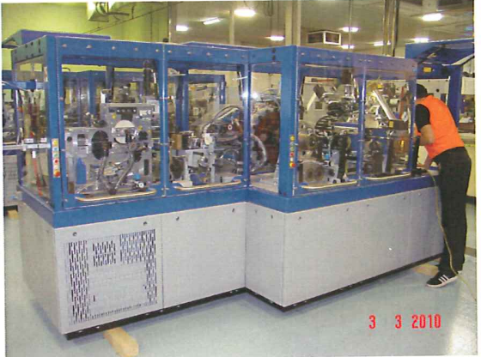
Seaworthy packaging does not necessarily mean corrosion-free arrival
Judgment of the Swiss Federal Supreme Court of 2 November 2015, 4A_318/2015
Vesna Polić Foglar
September 19, 2024

Slide 2
Contents
1
Who is who and what happened
2
Surveyors’ reports
3
Surveyors’ findings
4
Next steps
5
Legal action before the Commercial Court
6
Appeal to the Swiss Federal Supreme Court
7
German case law

Slide 3
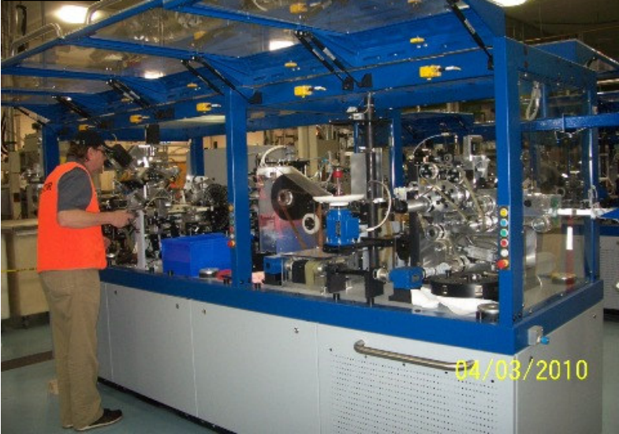
Who is who and what happened
R (Plaintiff and Appellant) is a relatively small but successful Swiss manufacturer of systems for the production of tampons for menstrual hygiene.
It regularly works with E, (Defendant and Respondent), that supplies all types of packaging, including corrosion protection.
In the year 2009 the plaintiff received a substantial order to produce five custom-made machines for a customer in Australia.

Slide 4
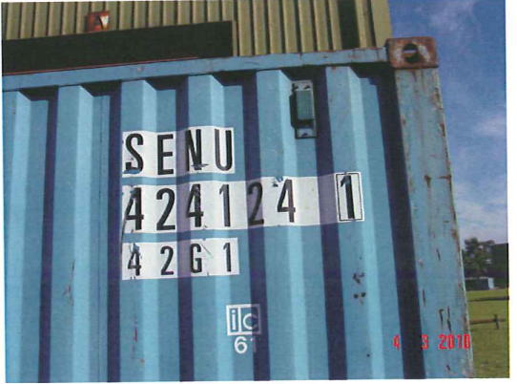
Who is who and what happened (cont’d)
In November 2009, the plaintiff asked the defendant to pack the machines so that they would be seaworthy.
The five machines, complete with their control cabinets, were packed into three containers – two main machines in two 40-foot containers and one main machine in one 20-foot container.
A third party freight forwarder was used for the sea transport to Melbourne.

Slide 5
Who is who and what happened (cont’d)
R had its usual marine insurer F. Because this shipment was larger than any previous one, and because the new buyer was particularly important in the new Australian market, R took out an additional policy with A for this shipment only.
E, on the other hand, had its business liability insurance with insurer X.
When the machines arrived in Australia on 8 and 9 February 2010, the buyer discovered serious corrosion damage and informed the plaintiff immediately.
The damage came as a shock to everyone involved, as everyone was convinced that all possible precautions had been taken in view of the importance of the shipment. A meeting of the companies involved, and their insurers, was convened at the premises of packer E.

Slide 6
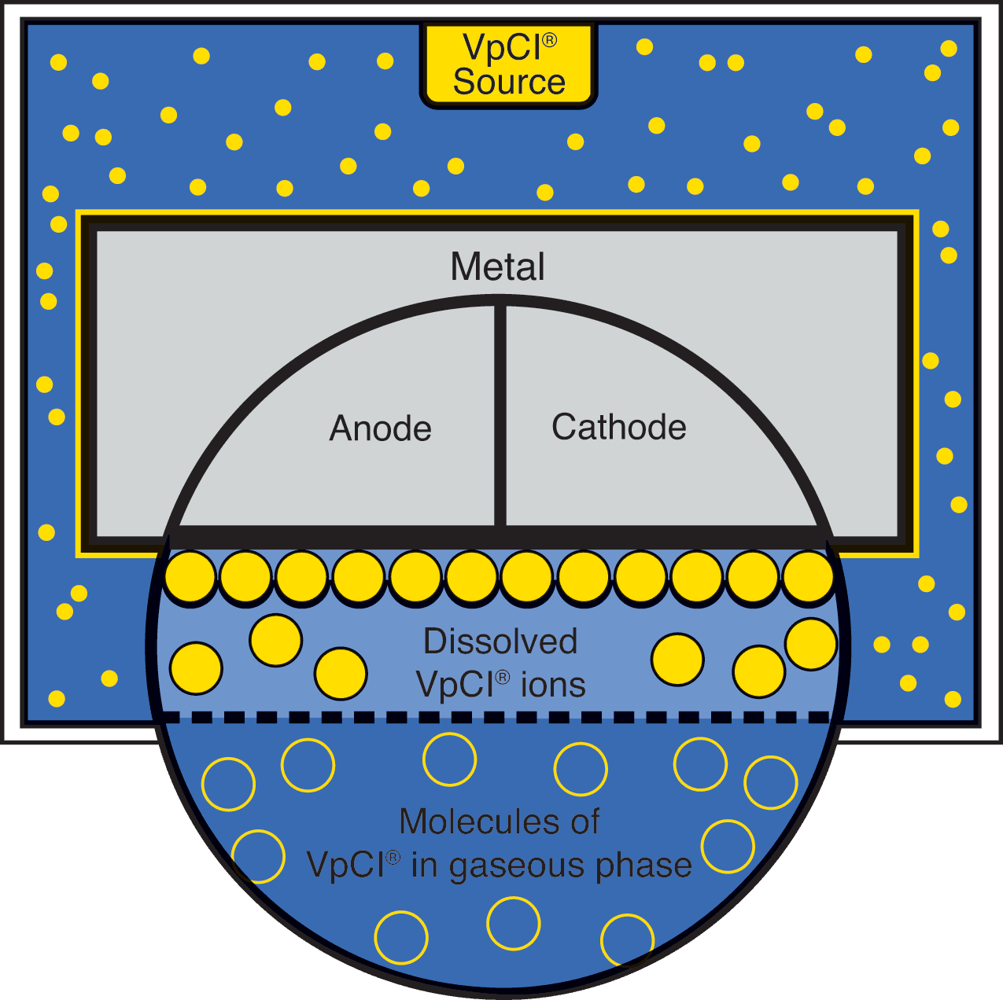
Who is who and what happened (cont’d)
E's staff explained how the machines were protected by the films and, in particular, the use of packaging containing VCI products (VCI stands for 'volatile corrosion inhibitor') to protect against corrosion (VpCI for 'vapour phase corrosion inhibitor' is a trademark of the manufacturer C.). This process is essentially based on the use of volatile inhibitors (molecules) to form a protective layer on the surface of the goods so that corrosion cannot occur.
The employee who carried out the packaging in question mentioned himself that more VpCI dispensers should probably have been used.

Slide 7
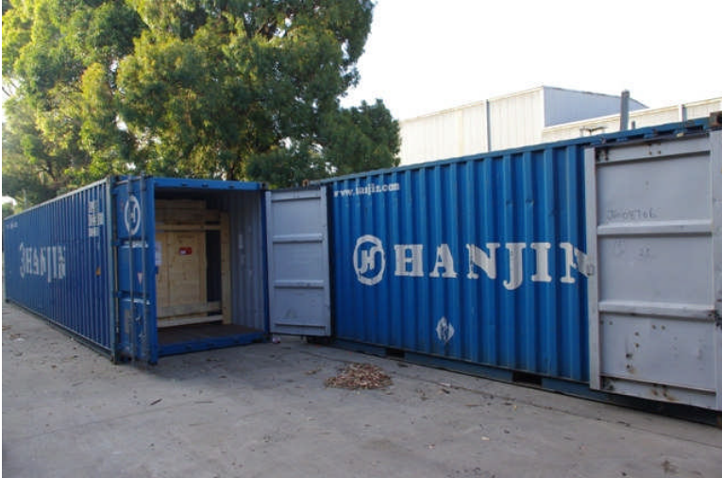
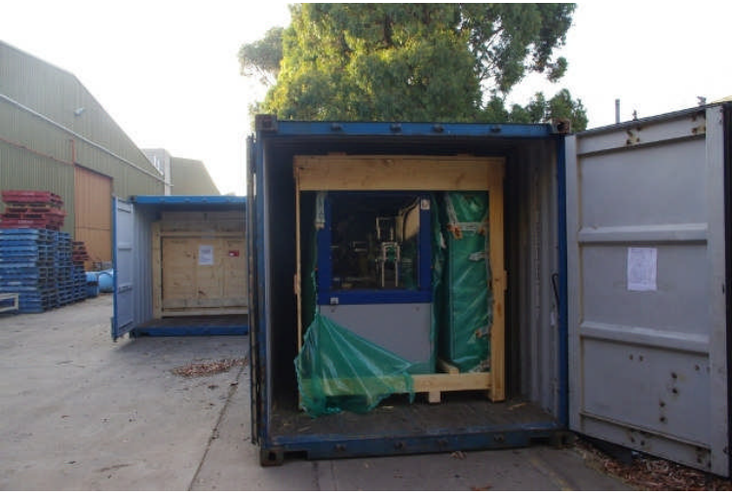
Surveyors’ reports
Insurers have commissioned several experts to inspect the damage
Initial opening of one of the containers
One case partially open for inspection

Slide 8
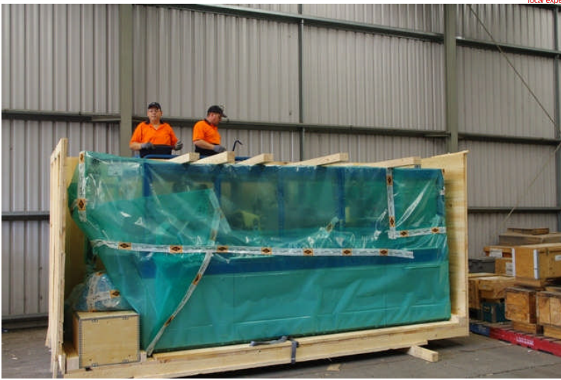
Surveyors’ reports (cont’d)
Wooden crate is being dismantled
The packaging appeared intact with no signs of external intervention like impact or water ingress.
Only when the layers of packing foil were removed the full extent of the damage became evident.

Slide 9
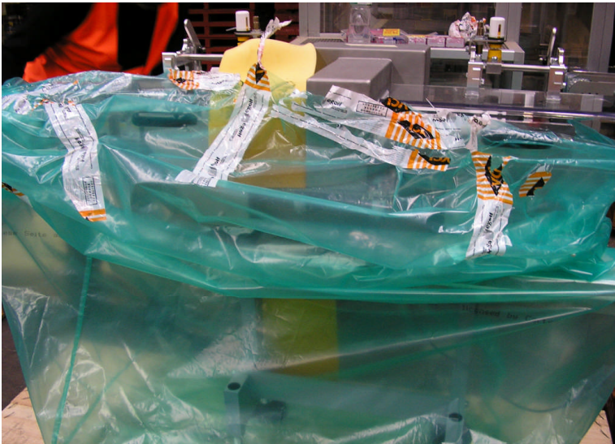
Surveyors’ reports (cont’d)
Packer’s adhesive tapes used
The various sections of foil were struck together with E’s adhesive tapes used to seal over the laps. This sealing had not always been very thorough.

Slide 10
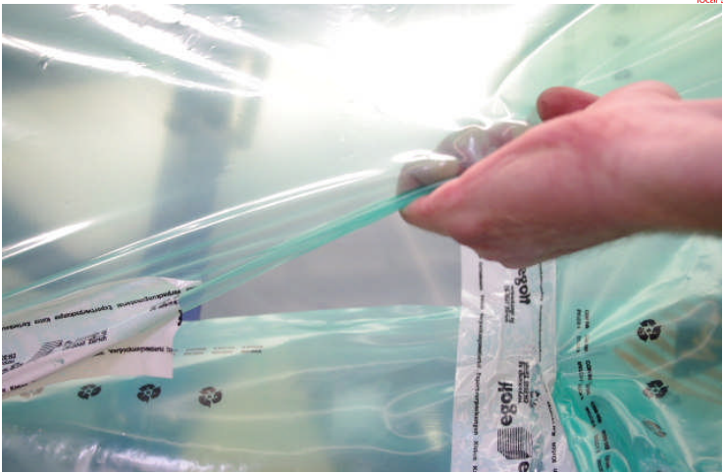
Surveyors’ reports (cont’d)
Unsealed gap confirms the source of excess moisture ingress from the ambient surroundings.
In some instances, there were gaps between the foil sections where “one could put an arm through”, and when doing so small droplets of condensation were noted on the inside of the foils.
One of unsealed gaps was of at least 40 cm.

Slide 11
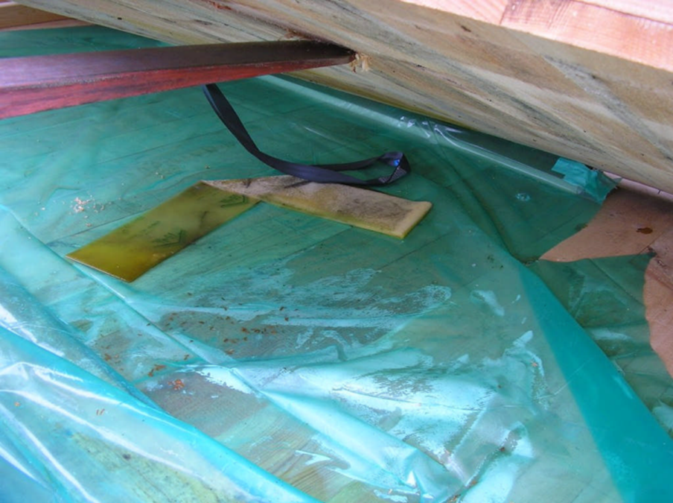
Surveyors’ reports (cont’d)
VpCI Dispenser can be seen within the closed housing of one of the main machines.

Slide 12
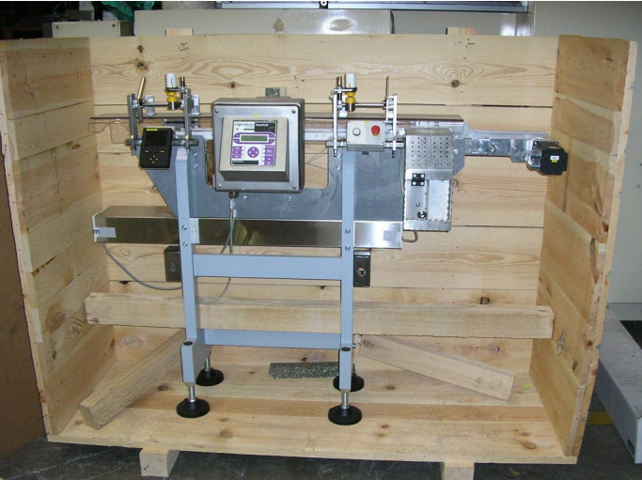
Surveyors’ reports (cont’d)
The other item in the large wooden case was the control cabinet, which had been well wrapped in a single layer of film, and well sealed.
Each control cabinet had one foam pad dispenser inside. Damage to the control cabinets was minimal. Only two of the five control cabinet showed any signs of corrosion damage, and these were minimal in comparison to the rest.

Slide 13
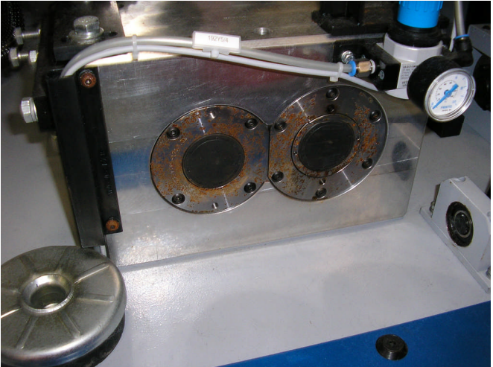
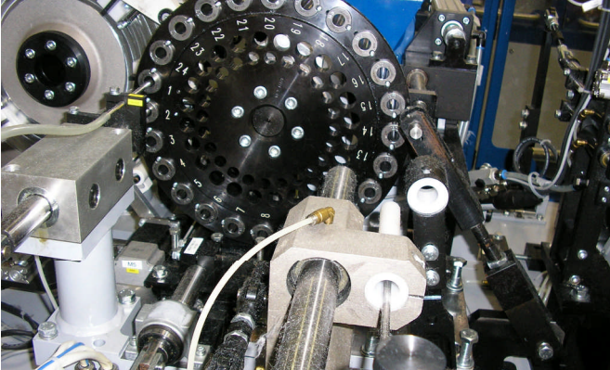
Surveyors’ reports (cont’d) - Corrosion examples
Pitting corrosion on binding drums and other parts of the machinery

Slide 14
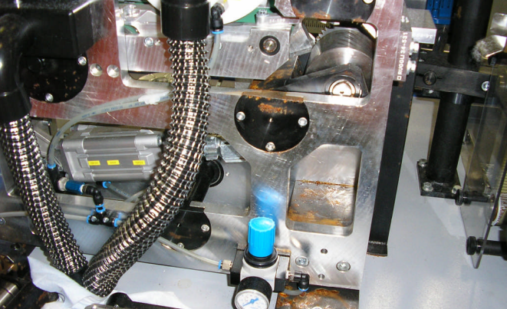
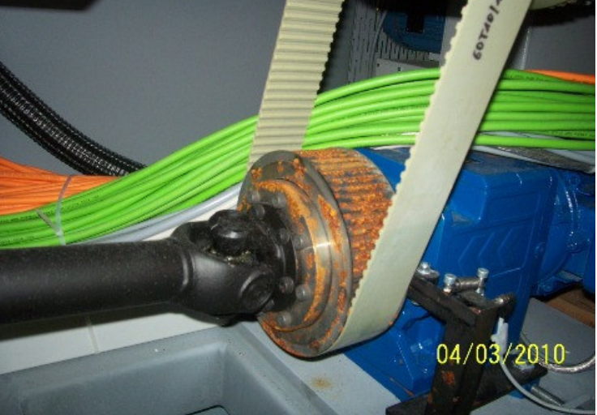
Surveyors’ reports (cont’d) - Corrosion examples
Pitting corrosion on parts of the machinery

Slide 15
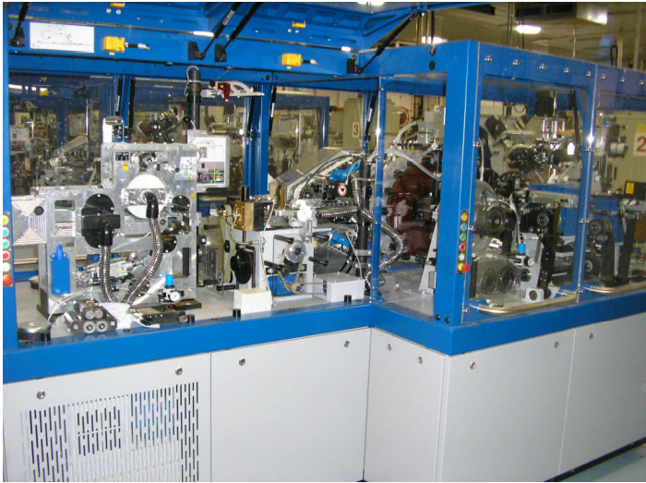
Surveyors’ findings
Each main machine had a maximum of four foam pads, each measuring 6 x 200 x 1450 mm, two at the upper and two at the lower part. The internal space of the top section may have warranted the use of more than two foam dispensers.
There was no VCI oil on high mass unprotected steel parts, no drain slots in bottom sheets and the packages were not properly sealed. The machines had not been packed in accordance with the manufacturers’ guidelines.
Each control cabinet hat one foam pad and each exit conveyor had one foam pad.

Slide 16
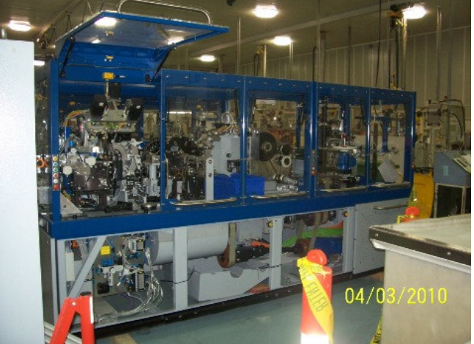
Surveyors’ findings (cont’d)
There was no external damage when the crates were removed from the containers. Dismantled crates did not reveal any sign of cracks, gaps or holes caused by external impact.
There were no cracks, or holes in the foil, but not all the main machines were completely sealed.
The wrapping did not have sufficient lengths of excess foil that could be held together, folded back and sealed.
No desiccant units were reported or sighted.

Slide 17
Surveyors’ findings – Damage
The main internal components of the machines showed surface rust or in some cases, extensive pitting corrosion already setting in. The affected parts have been the unprotected internal steel parts, namely those that have had no powder coating to protect their surfaces. The machines were not sprayed with VCI film over the surfaces before these were wrapped in foil, as recommended by C, the manufacturers of the foils.
It is possible that the use of up to 4 VpCI foam dispensers for each main machine, two on the upper and two on the lower part, may have been insufficient for the internal volume of the machine.
There was no corrosion damage on the external panels which were painted or powder coated and as such did not have any exposed bare metal.
Rust and corrosion - rust patterns typical of "cargo sweat", i.e. condensation of atmospheric moisture on parts which had maintained a low temperature when the goods were moved to warmer areas, were observed, particularly on the heavy/high mass unprotected steel parts.

Slide 18
Surveyors’ findings – Damage (cont’d)
The manner in which the foils were wrapped in some cases did not have sufficient overlap along the edges to be folded back and sealed properly. This allowed air gaps to allow the entry of air and moisture. Instead of using E’s adhesive tapes to form larger sections of foil, these should have been heat sealed or the edges welded to ensure total air tightness.
None of the machines or the control cabinets had any drain holes at the bottom of the packaging.
There was no evidence of seawater chlorides.
Not all C’s recommendations have been adhered to.
It is highly likely that compliance with all protection measures may have assisted in preventing, if not totally avoiding the condensation corrosion that developed when the 3 containers were moved from a cold environment (Europe in late November) to Australia in mid-summer (early February).

Slide 19
Next steps
R was forced to return the machines to its premises for a complete overhaul. The customer had to be supplied with new machines due to deadlines and the start of production of a newly launched product that was to be manufactured on these machines.
R reported the damage to its two transport insurers. Although they helped him by appointing experts, assisting him in negotiations with the packer, etc., they were unable to cover the damage because the transport insurance policies expressly excluded damage caused by humidity, temperature influences and temperature fluctuations, and unsuitable or inadequate packaging, which were clearly identified as the cause of the damage.
E's business liability insurer also rejected the claim because it did not recognise the liability of its policyholder.

Slide 20

Legal action before the Commercial Court
As a result, R had no choice but to take legal action against its long-standing business partner E. On 6 September 2011 it filed a lawsuit with the Commercial Court of the Canton of Zurich, a specialised court for commercial disputes, requesting that the defendant be ordered to pay it CHF 6,168,713.35 (ca 6 600 000 Euros) plus interest at 5% since 10 February 2010.
The Commercial Court apparently didn't take into account the expert reports submitted with the claim - one from an expert who flew to Melbourne to see the rusted machinery, and two from established local experts. They all documented the situation thoroughly and gave their opinions on the cause of the damage.
In any case, Swiss courts treat expert reports as mere party statements, regardless of the quality of the report and the professionalism and impartiality of the authors.

Slide 21
Legal action before the Commercial Court (cont’d)
The Commercial Court therefore appointed its own expert, allegedly one of the prestigious Swiss Federal Laboratories for Materials and Technologies (EMPA). There is no record of whether this expert inspected the machines in Australia or back in Switzerland, or whether he inspected them at all, but he concluded that severe chloride contamination was the cause of the damage.
In its judgement of 8 May 2015, the Commercial Court dismissed the claim. Based on the opinion of its own expert, the court concluded that the plaintiff had not proven the causal link between the alleged breach of contract and the damages claimed. The court considered the defendant's subsidiary allegation of false information by an employee of the defendant to be unsubstantiated due to a lack of evidence, despite a dispute.

Slide 22
Appeal to the Federal Supreme Court
In an appeal in civil matters dated 15 June 2015, the plaintiff requested that the judgement of the Commercial Court of the Canton of Zurich dated 8 May 2015 be set aside and that the defendant be ordered to pay the amount claimed.
Alternatively, the judgement should be set aside and the matter referred back to the lower court for a new decision. It maintains its position that the respondent had guaranteed that the machines were free of corrosion on arrival in Australia.

Slide 23
The considerations of the Federal Supreme Court
(2.3) The court expert clearly denied the causal link between the packaging and the corrosion damage.
Rather, he considered severe chloride contamination to be the cause of the damage.
The lower court considered these statements to be clear, consistent and comprehensible. It held that the expert's statement was also consistent with the rest of the file, so that the packaging could not be regarded as the predominantly probable cause of the damage.

Slide 24
The considerations of the Federal Supreme Court (cont’d)
In particular, the lower court concluded that none of the expert reports obtained by the parties contained a clear and comprehensible statement on the cause of the corrosion, that these reports contradicted each other in part and remained vague in their conclusions, as the appellant itself stated.
Insofar as the appellant questions the conclusions of the court's expert opinion at all - and does not claim that the respondent is also responsible for chloride contamination on the machines by expanding the established facts - its submissions are limited to appellative criticism. It is therefore not to be heard.

Slide 25
The considerations of the Federal Supreme Court (cont’d)
(3) According to the findings in the contested judgment, the respondent undertook to produce ‘seaworthy packaging for the 5 systems, including corrosion protection with VpCI film and dispensers, IPPC standard’. The parties agree with the lower court that the respondent has thus assumed the contractual obligation to produce the agreed packaging.
(3.1) The lower court did not accept the appellant’s view that the respondent had undertaken to deliver the five machines to Australia free of corrosion. It considered it clear that, in the offer of 23 November 2009, the respondent offered the appellant packaging including corrosion protection with VCI films and dispensers in accordance with the IPPC standard, i.e. packaging that protects against corrosion.

Slide 26
The considerations of the Federal Supreme Court (cont’d)
The lower court was unable to recognise that the respondent had offered a corrosion-free arrival of the goods or packaging that would guarantee a corrosion-free arrival in its offer.
The minutes of the meeting of 25 February 2010 referred to by the appellant also do not allow any conclusion to be drawn in the appellant’s favour. According to the finding of the lower court, it only states that the machines should be able to be unpacked in Melbourne in the same condition as they were picked up. The lower court concluded that the parties had agreed that the respondent should provide the packaging with corrosion protection using VCI films and dispensers in accordance with the IPPC standard, which in the normal course of events would prevent the kind of corrosion that could occur on the sea route to Australia.

Slide 27
The considerations of the Federal Supreme Court (cont’d)
(3.2) The appellant maintains its view that effective corrosion protection was guaranteed in the sense that the respondent was liable for the corrosion-free arrival of the machines in Australia. To the extent that it wishes to derive such a guarantee from the fact that the agreed success is owed under the contract for work and services, it ignores the contractual agreement. The work - which the respondent was contractually obliged to successfully produce - is contractually defined as the packaging of the machines in accordance with the specifications for guaranteeing corrosion protection ‘with VCI film and dispensers, IPPC standard’. The contractual success is therefore packaging that fulfils these requirements.

Slide 28
The considerations of the Federal Supreme Court (cont’d)
The appellant also claimed before the lower court that the packaging did not meet these requirements because, on the one hand, an insufficient number of VCI dispensers (i.e. foam strips that release VCI) had been used and, on the other hand, the VCI protective film had been incorrectly attached; it had claimed that the respondent had disregarded the manufacturer's guidelines.
(3.3) The lower court correctly interpreted the parties' contract, concluding that the respondent had undertaken to manufacture packaging for the machines that was provided with VCI corrosion protection (or VpCI protection from the manufacturer C). Since the fundamental effectiveness of this protection is not questioned by either party, the lower court correctly concluded that, in the normal course of events, this can prevent the corrosion of the machines that can occur without protection during sea transport.

Slide 29
The considerations of the Federal Supreme Court (cont’d)
(4.) The appellant claims that this damage was caused by the allegedly defective fulfilment of the contract by the respondent. It is claiming damages based on Art. 97 para. 1 of the Swiss Code of Obligations and has to prove this in accordance with the general rule of Art. 8 of the Swiss Civil Code: Its damage, the breach of contract by the respondent and the - natural and adequate - causal link between the breach of contract and the damage. According to established practice, the standard of proof for proving the natural or hypothetical causal link is the preponderance of probability.
The burden of proof was on the appellant to show that the corrosion damage to the machines was with overwhelming probability caused by the alleged defect in the packaging, or that it would with overwhelming probability have not occurred if the machinery had been packaged in accordance with the contract, i.e. in accordance with the VCI corrosion protection regulations.

Slide 30
The considerations of the Federal Supreme Court (cont’d)
The lower court correctly examined whether there were other causes that could have caused the corrosion damage with a higher or equally high probability than the alleged defect in the packaging. It thus correctly understood the standard of proof of preponderance of probability, because according to this standard, evidence is deemed to have been provided if there are such weighty reasons in favour of the correctness of the factual allegation from an objective point of view that other conceivable possibilities cannot reasonably be considered to a significant extent.
By clarifying the possibilities that could actually be considered as the cause of the corrosion found on the machines, the lower court neither misjudged the subject of the evidence nor incorrectly allocated the burden of proof.

Slide 31
The considerations of the Federal Supreme Court (cont’d)
Considering severe chloride contamination as a conceivable possibility of the cause of the damage, there is no preponderance of probability that the packaging was the predominantly probable cause of the damage. The appellant therefore failed to prove his case.
(5.) Finally, the appellant repeats its subsidiary allegation already submitted to the lower court, according to which the respondent is liable for false information. It criticises the consideration in the contested decision that it did not provide any evidence for the allegedly false information provided by an employee of the respondent. It claims that this allegation is not true. However, it is not clear from its submissions which evidence it offered for which allegations before the lower court. In this respect, the complaint cannot be accepted.
The appeal is dismissed.

Slide 32
In a nutshell:
The Federal Supreme Court said:
cause of corrosion damage is not moisture ingress through improperly sealed foils or inadequate use of corrosion inhibitors, but severe chloride contamination of the metal surfaces of the machines.
There is no causal link between the packaging and the corrosion damage.
The contract for work and services (Art. 363 of the Swiss Code of Obligations) for "seaworthy packaging, including corrosion protection" was for "packaging of the machines in accordance with the specifications for ensuring corrosion protection 'with VCI film and dispensers, IPPC standard'", but was not a guarantee that the machines would arrive free of corrosion.

Slide 33
German case law
In general, there are few Swiss court decisions in the field of transport law. Swiss lawyers and judges therefore often look up to German case law.
There are two German court decisions that deal with almost identical situations as the Swiss case in question, but the courts' position is diametrically different.

Slide 34
Higher Regional Court (Oberlandsgericht) Hamburg
Decision dated 24 January 2019 − 6 U 277/15
The plaintiff seeks a declaratory judgement that the defendant is liable to pay damages due to faulty packaging of machine parts that were to be transported from Germany to Korea. The law on contracts for work and services is applicable. The main content of the contract concluded between the plaintiff and the defendant was packaging.
In the case of a contract that provides for a crate made of ‘multiple waterproof glued’ plywood and the addition of a desiccant, and which also expressly refers to ‘preservation’ and ‘seaworthy packaging’, the contractor owes packaging that protects the goods to the necessary extent against water damage, which is likely to occur during transport from Germany to the country of destination.

Slide 35
Higher Regional Court (Oberlandsgericht) Hamburg (cont’d)
Decision dated 24 January 2019 − 6 U 277/15
If the protective measures prescribed by law or technical standards are not taken when packaging goods and the danger that the protective measures are intended to prevent materialises, prima facie evidence suggests that the damage would have been avoided if the relevant regulations had been observed.
It can be assumed that the corrosion damage is causally attributable to the breaches of duty by the defendant. This is already supported by prima facie evidence.

Slide 36
Regional court (Landesgericht) Essen
Decision dated 2 August 2023 − 44 O 17/17
A machine was packed and transported to China, where moisture damage was discovered.
A contract for the packaging of goods is subject to the law on contracts for work and services.
A packaging is only seaworthy if it is so watertight that it protects the transported goods from heavy rain, standing water and condensation for a foreseeable period of time.
If the prescribed protective measures are not taken and the danger that the protective measures are intended to prevent materialises, prima facie evidence suggests that the damage would have been avoided if the relevant regulations had been observed.

Slide 37
Regional court (Landesgericht) Essen (cont’d)
Decision dated 2 August 2023 − 44 O 17/17
In the event of water damage to packaged goods being transported overseas, there is prima facie evidence that the damage would have been avoided if the goods had been packed in a seaworthy manner.
The affixing of an umbrella symbol to the packaging by the packaging contractor does not constitute an obligation on the part of the client to store the goods under cover if seaworthy packaging is owed.

Slide 38
Vesna Polić Foglar
Of-Counsel
+41 43 500 48 50
polic@gbf-legal.ch

